Slide 1
A study on the modeling of the distribution automation systems using Petri Nets
Student: Huiyuan Xiao
Professor: Prof. Antonello Monti
Supervisor: Abhinav Sadu
Huiyuan Xiao

Slide 2
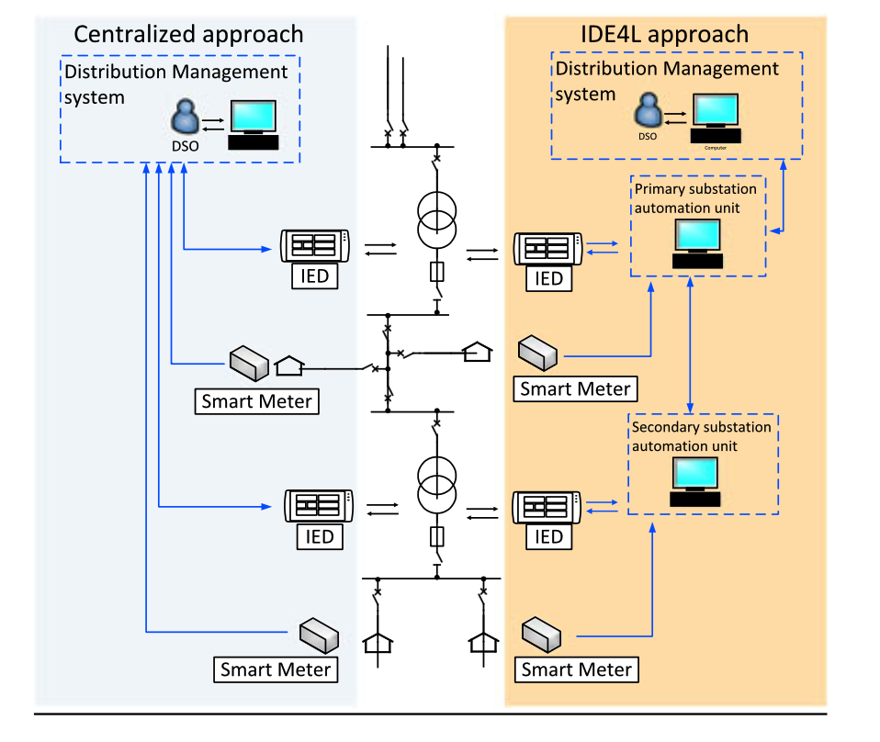
Motivation
Instantaneous change in state quantities
Volatility and randomness of new energy The complexity of control increases
Active adjustment on the demand side
Higher penetration of DGs The scale of control increases
Centralized automation
Distributed automation
(Substation Automation Units)
"Design and Implementation of a Substation Automation Unit.”
IEEE Transactions on Power Delivery 32.2 (2017): 1133-1142.

Slide 3
Aim
Goal
To employ different types of Petri Nets (SCPN,STPN) with different tools (PIPE, ORIS) for performance analysis of different distribution automation systems (Centralized Automation system v.s. IDE4L system) in Medium Voltage with different protection approaches.
Contribution
A feasibility study on using Petri Net theory for modeling and analyzing the distribution automation system
The flexibility of SCPN and STPN is illustrated by a detailed study on the 6 major use cases at the MV level of IDE4L.
The performance comparison of different architectures and protection approaches verify the advantages and necessity of the IDE4L system and the possibility of improvement. The analysis method can also be implemented in other system architecture.
Assumption
Advanced distribution automation system is deployed (IDE4L system)

Slide 4
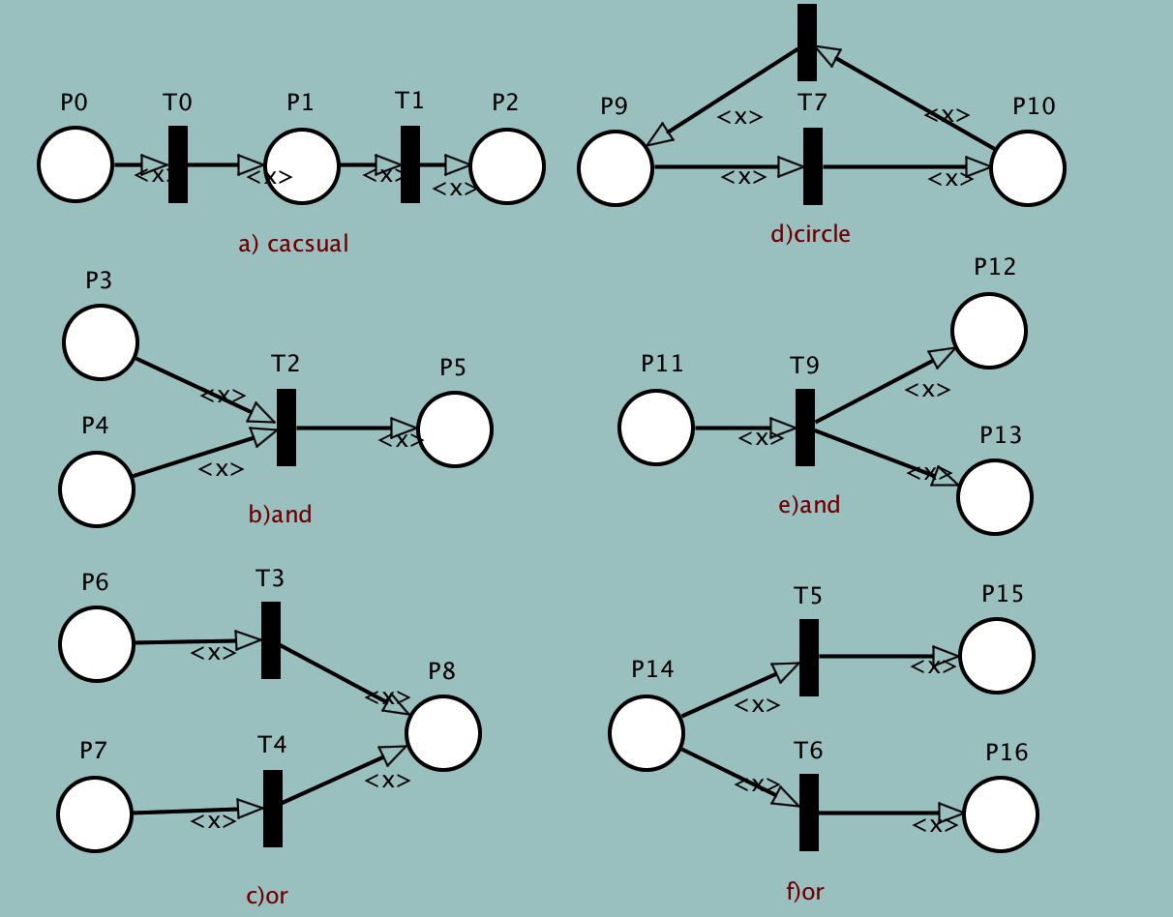
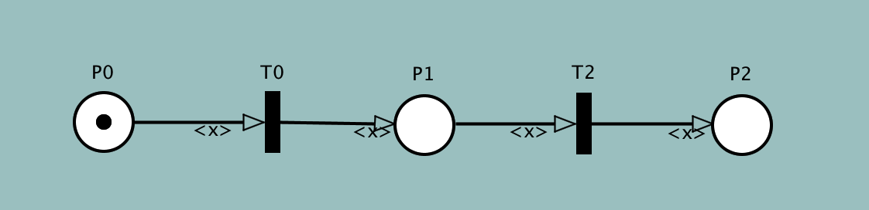
Petri Nets Basis
Petri net is a visual graphical mathematical modelling language to model static structure and dynamic change of Discrete Event Dynamic System (DEDS)
Place : a circle (P0,P1,92)
Transition: a rectangle (T0,T2)
Arc: a tangential arc between the place and the transition
Token: a dynamic object in the place (represented by a dot in the place P) that can be moved from one place to another
A structured description tool which is able to represent synchrony, synchronisation, and parallel logical relationships.
Basic logic connections:

Slide 5
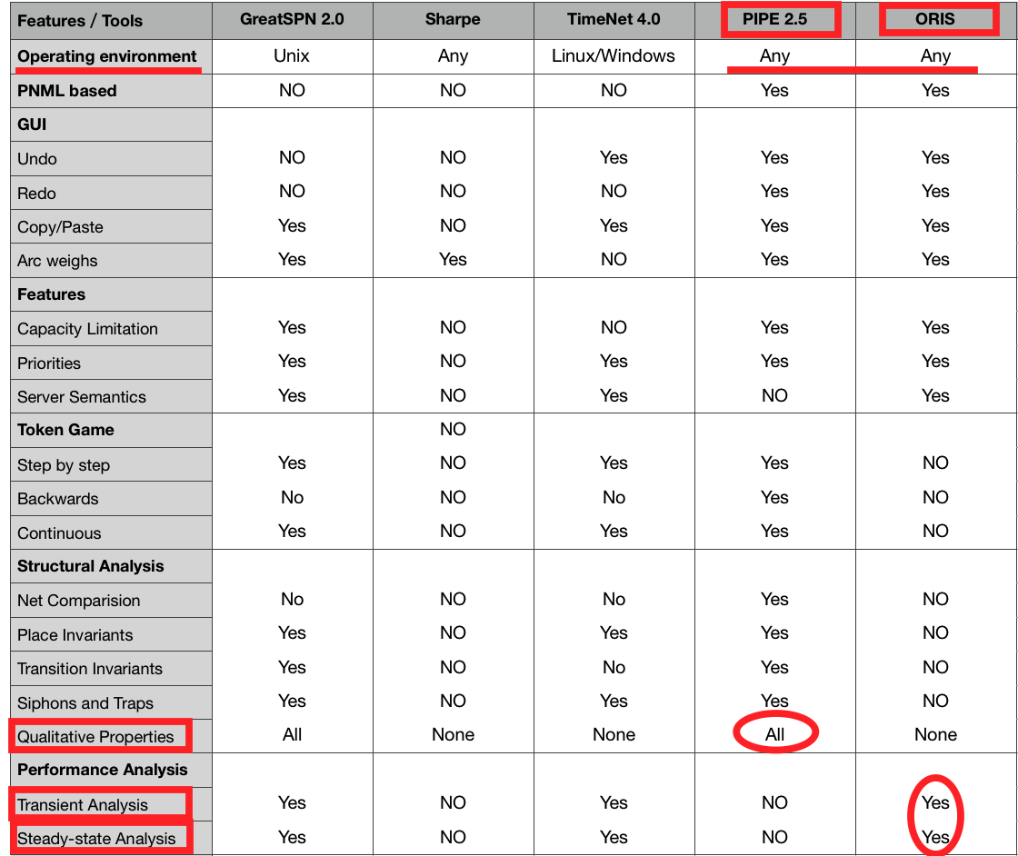
Petri Nets Types and tools
Petri net extensions
Vertical extension is from the basic P/T PN to advanced PN (such as predicate / transition PN, colored PN).
Horizontal extension is from traditional Petri nets to Timed Petri nets(TPN) and Stochastic Petri Net (SPN or STPN) .
Stochastic Colour Petri Net (SCPN)
can define and identify different tokens in the same place, thus completing a more complex logical network architecture
PIPE is friendly for colored token definition
Stochastic Timed Petri Net (STPN)
transition may have time delay which is randomly chosen
ORIS has various functions for transient and steady-state analysis
The different focusing aspects and different analysis needs of cases should be combined with the corresponding tool characteristics and personal preferences to complete the tool selection.
We choose PIPE and ORIS as simulation tools.

Slide 6
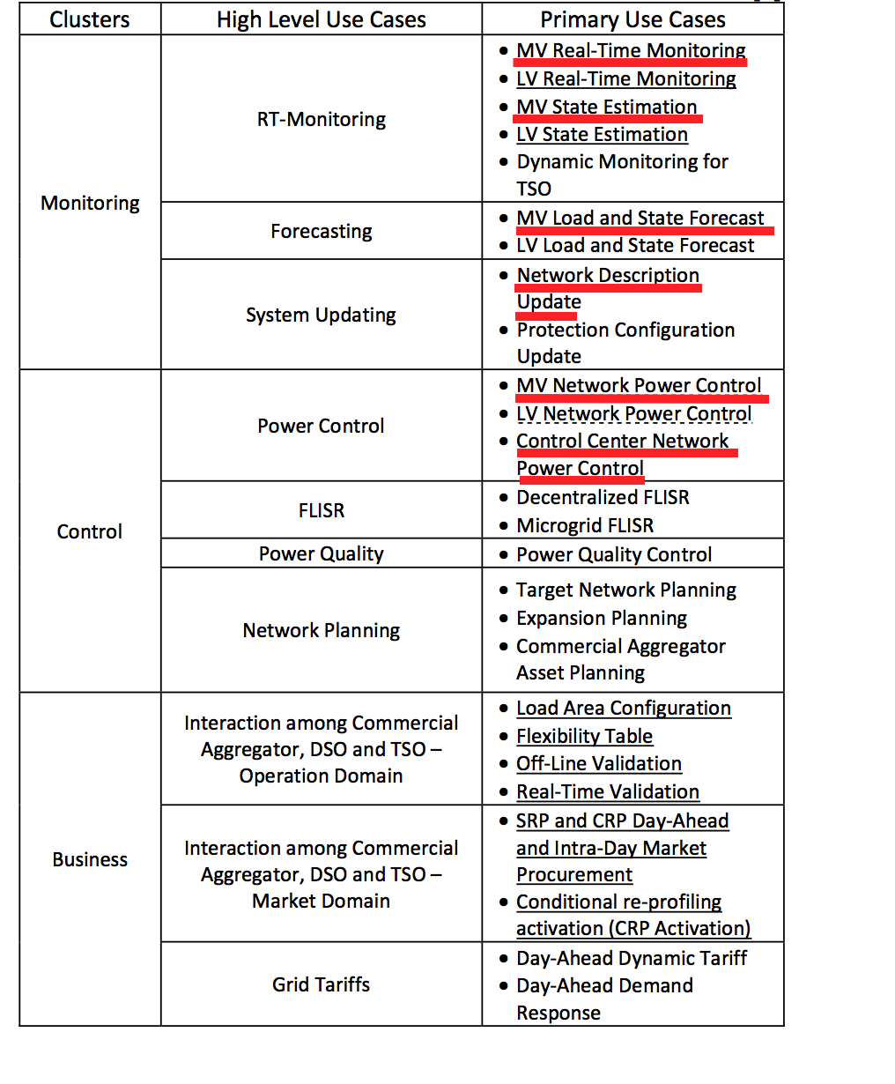
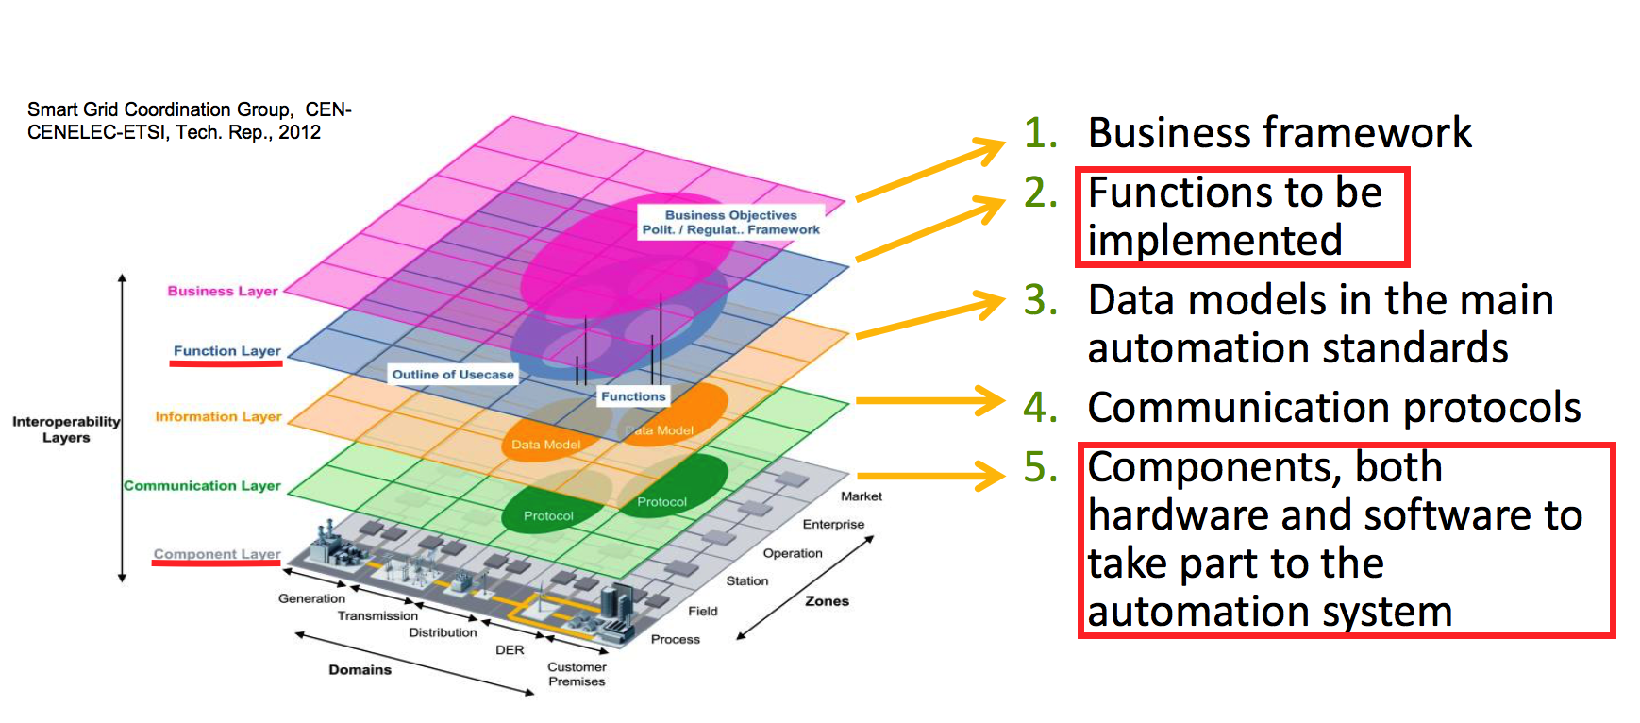
IDE4L project Automation concept and architecture
The automation architecture development of IDE4L is supported by two main concepts:
Use Case (UC) Methodology
Smart Grid Architecture Model (SGAM) framework
Deliverable 3.1: Distribution Automation Concept
Function layer： Survivability analysis
Component layer：Dependability analysis
We will focus on 6 major monitoring and control use cases in MV MVPC,MVRTM,MVSE,MVSF,NDU,CCPC

Slide 7
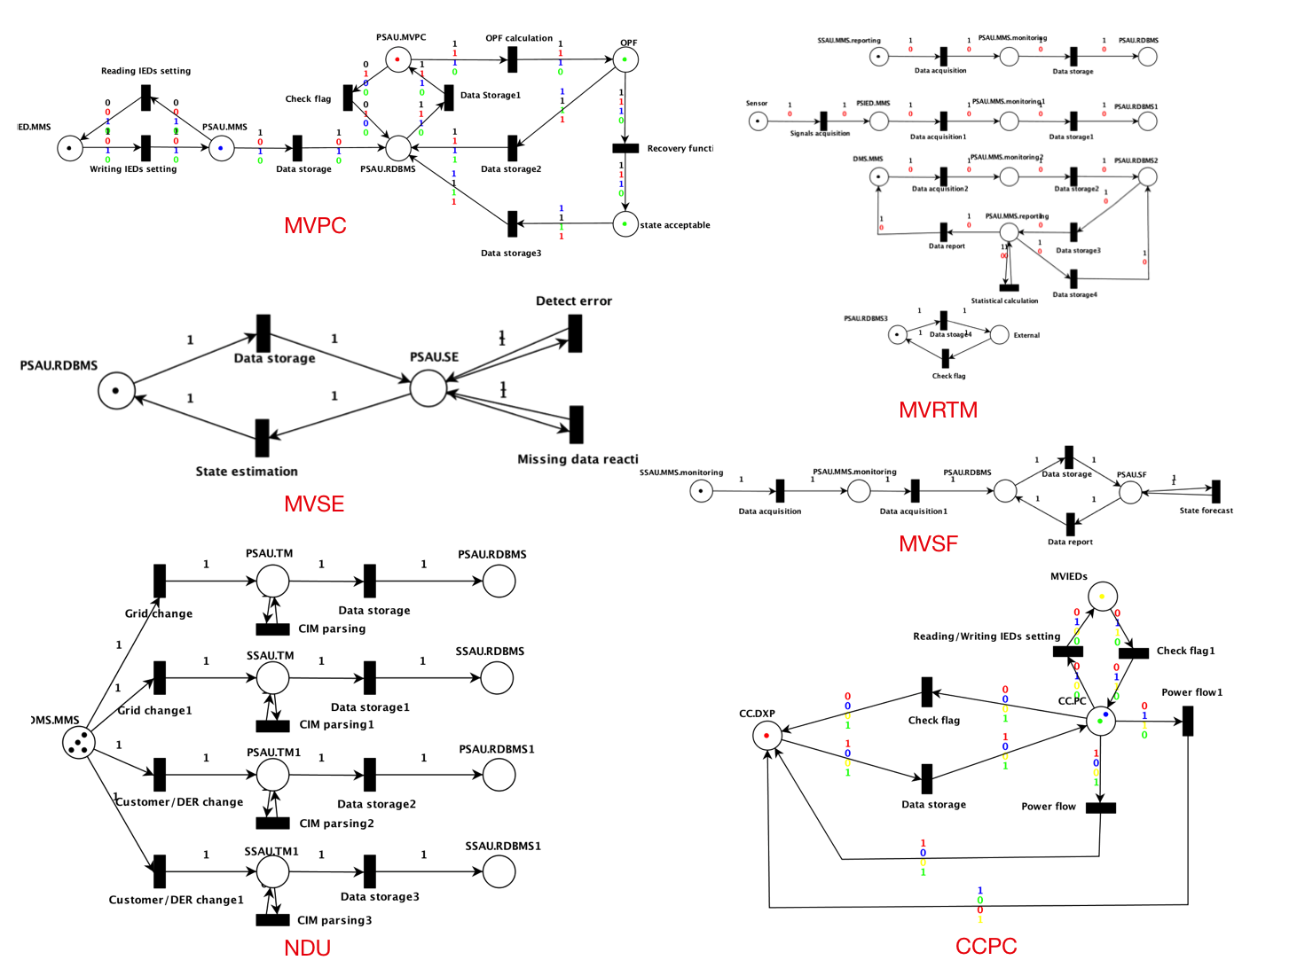
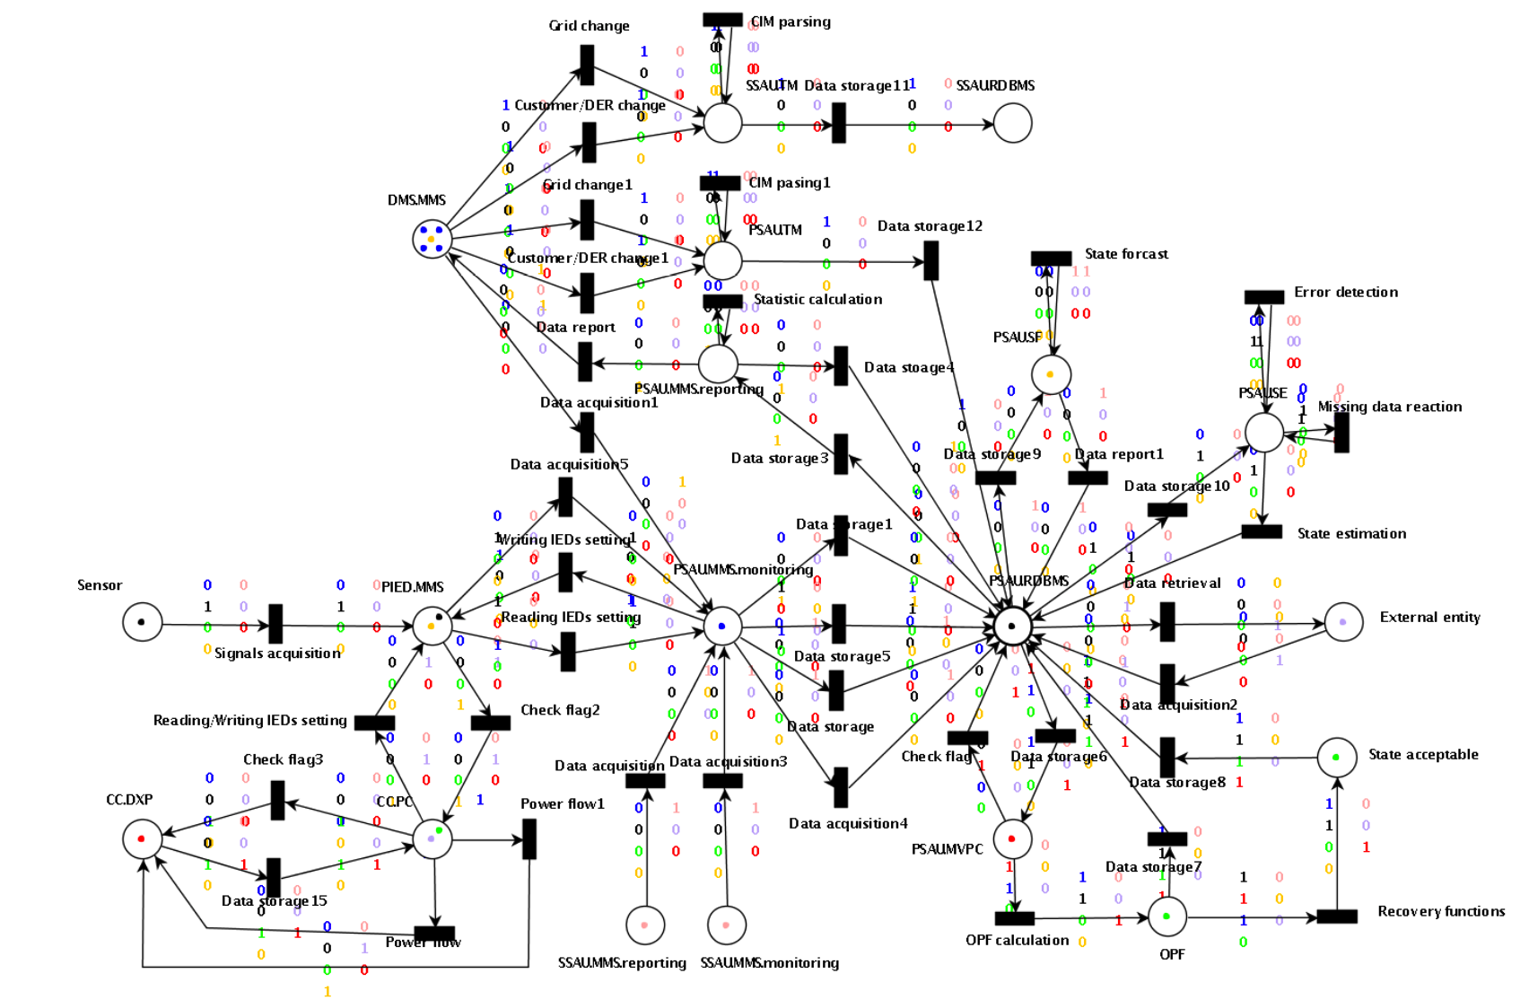
Performance analysis SCPN
MVPC,MVRTM,MVSE,MVSF,NDU,CCPC in PIPE
Left: seperated UCs; Right: whole system

Slide 8
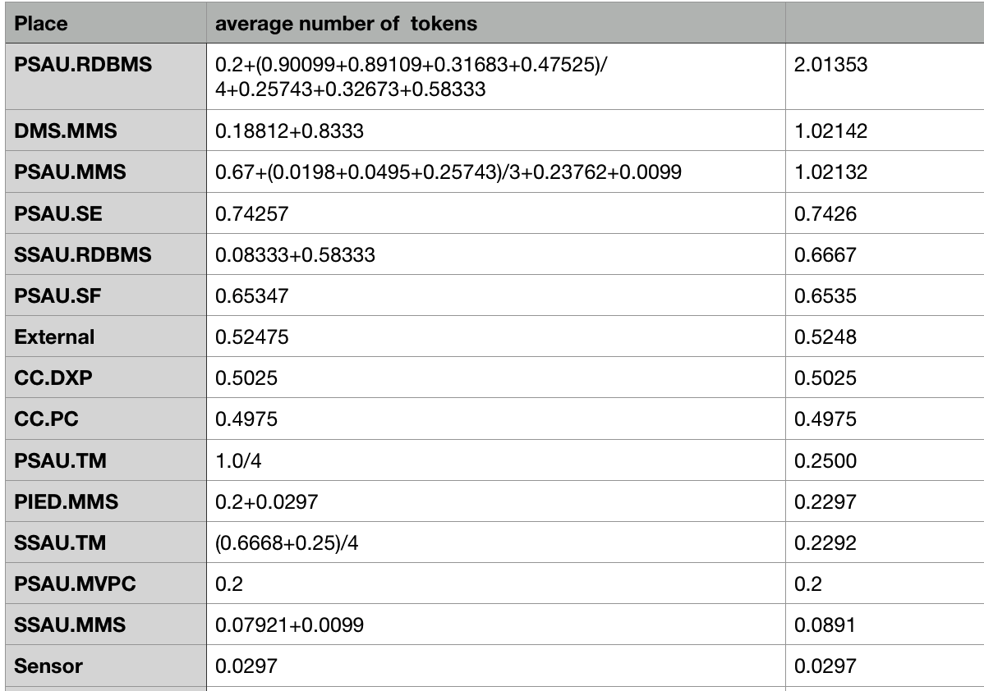
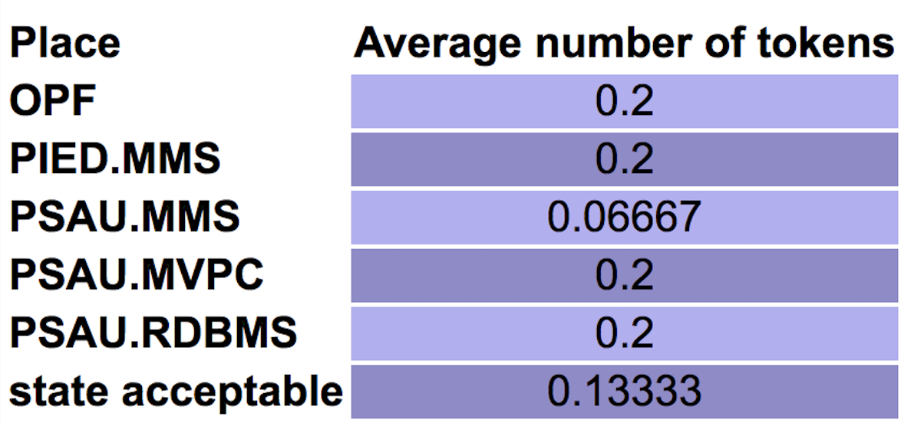
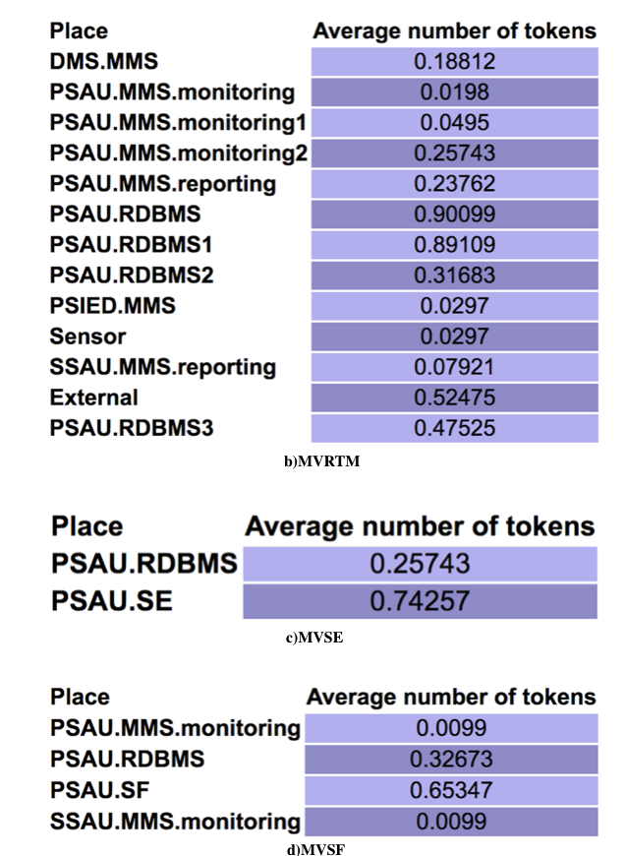
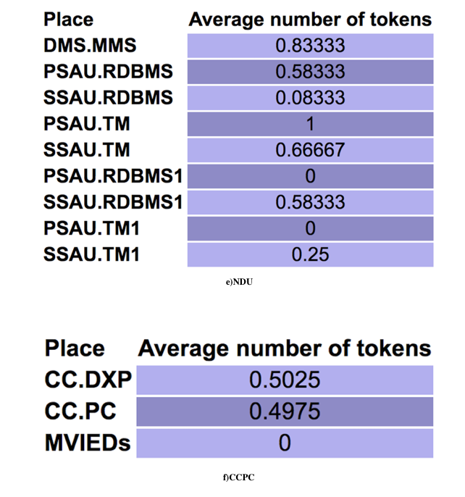
Qualitative analysis SCPN
We evaluate the importance of the different components to the function by calculating the average number of tokens passing through each place in 1000 transition firings(10 repeats )
In component level PSAU is the most important component
In function level PSAU.RDBMS(Relational database management system) has the greatest impact for survivability

Slide 9
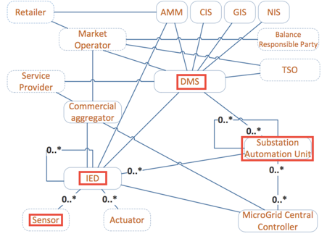
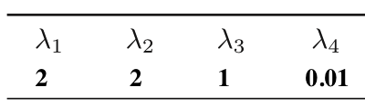
Performance analysis STPN: Settings
T_{CLF} T_{DC} T_{DPB} T_{DH}
The Firing Rates of Transitions
We separate Sensor, IED, PSAU and DMS into two states : normal operating mode (on) and failing down mode (down).
Three common ways for destroying the components: communication link failure, device physically breakdown and data corruption, which are separately denoted by transitions T_{CLF},T_{DC},T_{DPB}.
PSAU has a particular cause of failure:database hacked denoted by T_{DH.}
For simplicity, in this section, we first assume one substation network equipped with only Sensor, IED, PSAU, and DMS server to demonstrate the dependability evaluation procedures.
Then discuss several approaches to improve the dependability
Source:Zeng, Rongfei, et al. "Dependability analysis of control center networks in smart grid using stochastic petri nets.”
IEEE Transactions on Parallel and Distributed Systems 23.9 (2012): 1721-1730

Slide 10
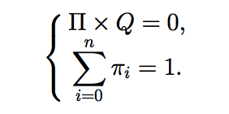

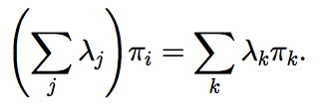
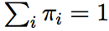
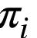
Performance analysis STPN: Calculation method of dependability
Calculation method of dependability for both steady-state and transient aspects involves two steps:
the analysis of the equivalent Continuous Time Markov Chain (CTMC)
and the computation of dependability
There are two equivalent methods to compute the steady-state probability of CTMC.
Specific mathematical calculations are very complex, fortunately ORIS's own performance analysis tools can quickly obtain analysis results (steady-state failure probability) both in data and graph.

Slide 11
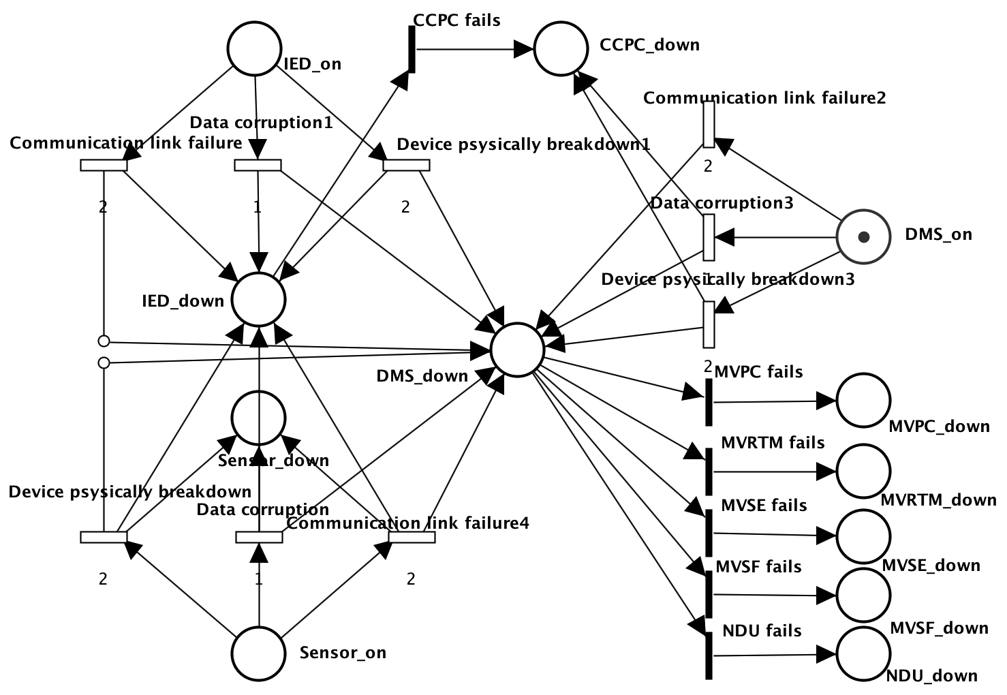
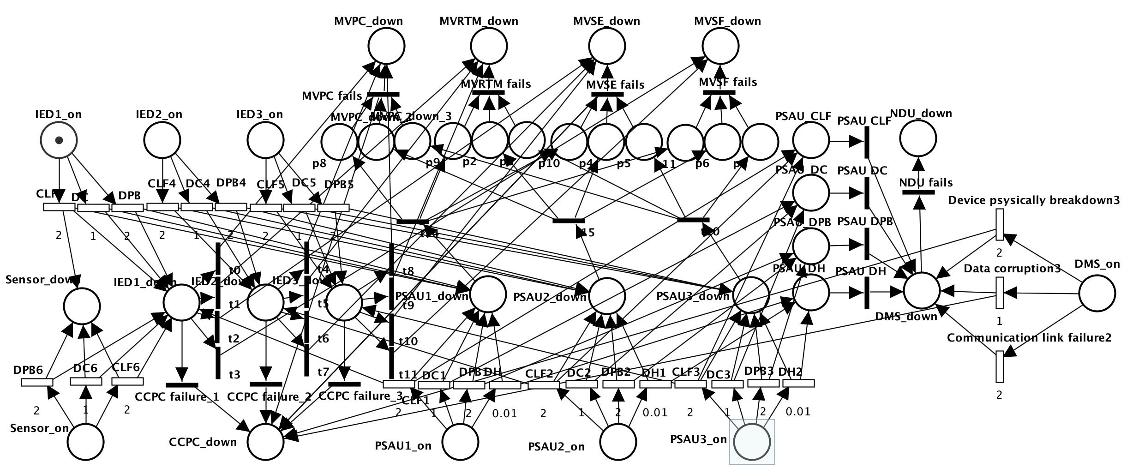
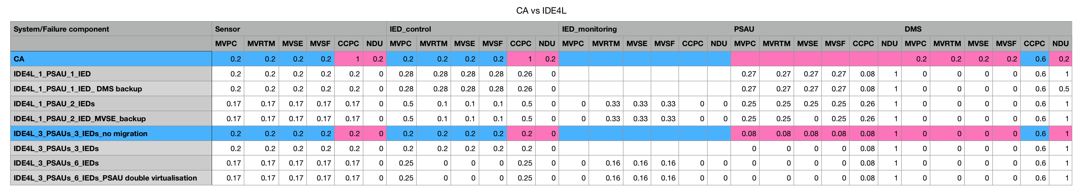
Performance analysis Centralized Automation(CA) vs. IDE4L
Centralized automation(CA) architecture
only one Sensor, one IED and one DMS
IDE4L architecture
One Sensors, three IEDs, three PSAUs and one DMS

Slide 12
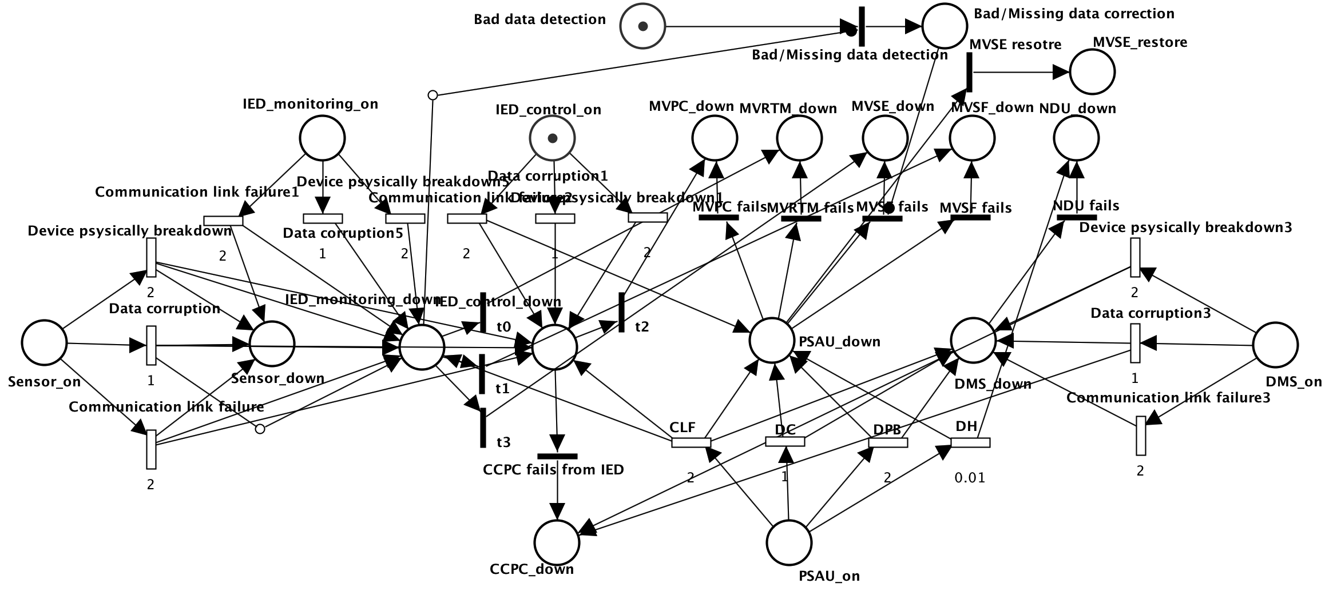
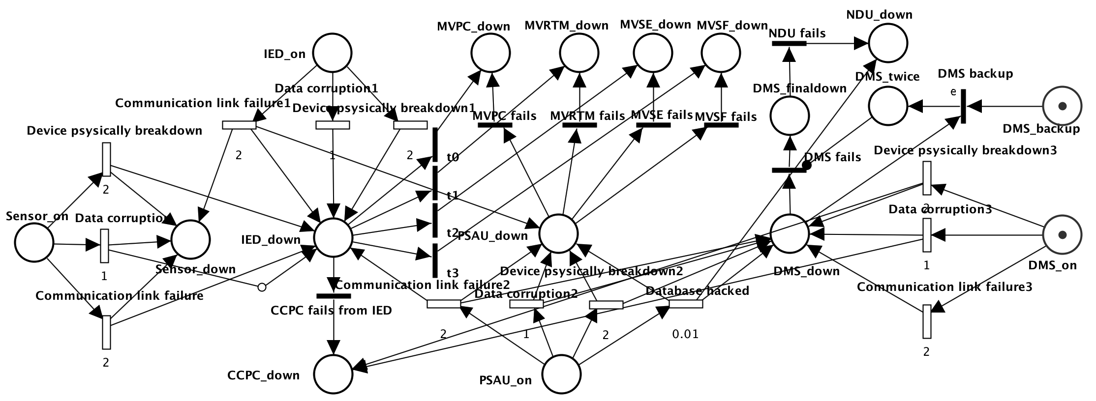
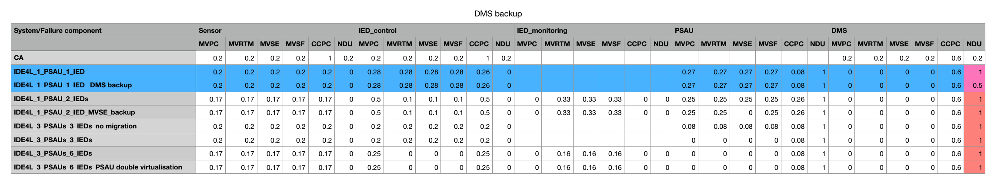
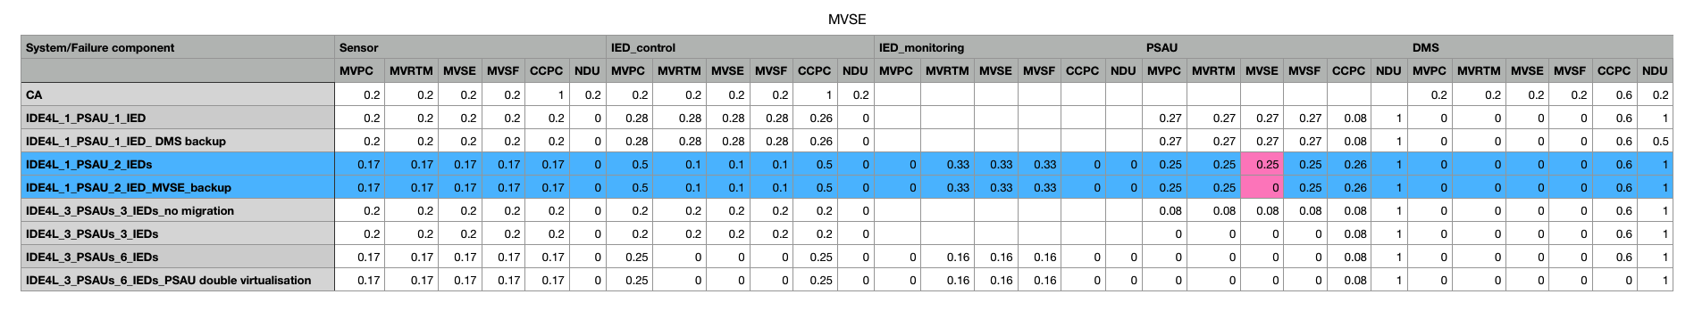
Protection approaches DMS-backup strategy
Protection approaches Bad/Missing data detection/correction
IDE4L automation distribution architecture with DMS-backup strategy
one Sensor, one IED, one PSAU and one DMS with Backup strategy
IDE4L automation distribution architecture with Bad/Missing data detection/correction
One Sensor, two separated IEDs, one PSAU and one DMS

Slide 13
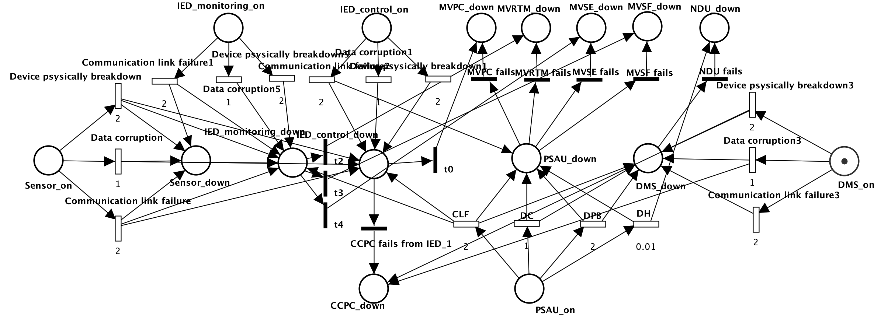
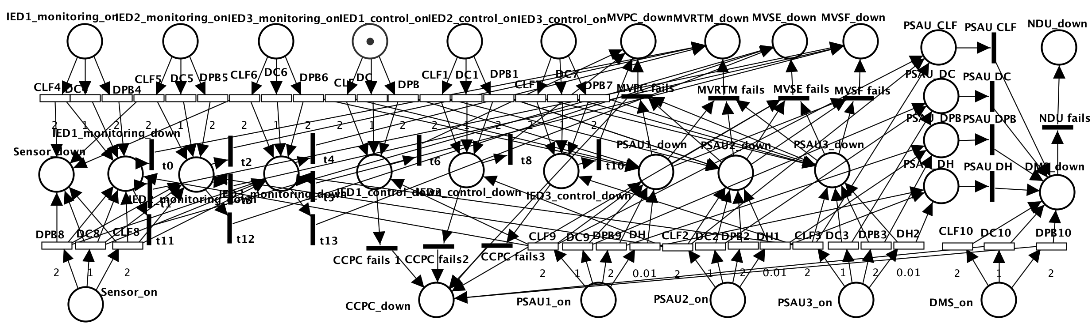
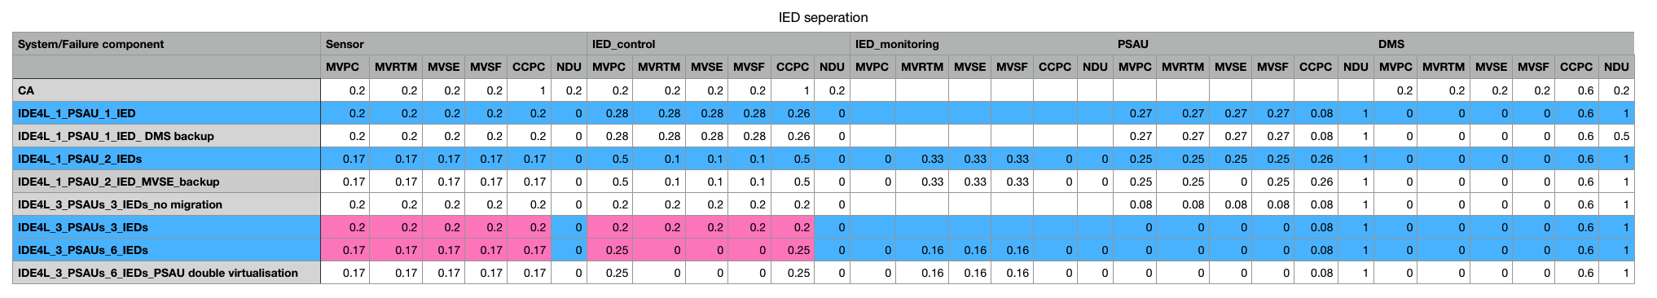
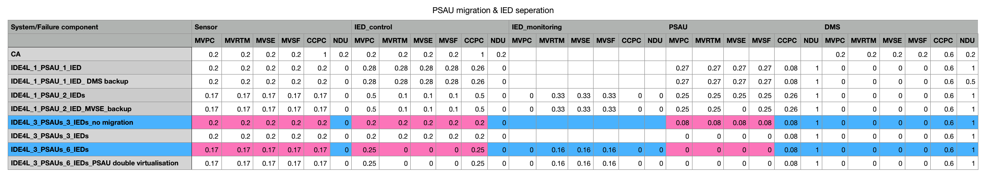
Protection approaches IED separation
Protection approaches IED separation & PSAU migration
IDE4L automation distribution architecture with separated IEDs
one Sensor, two IEDs(monitoring, control), one PSAU and one DMS
IDE4L automation distribution architecture with PSAU migration and separated IEDs
one Sensor, six IEDs, three PSAUs and one DMS

Slide 14
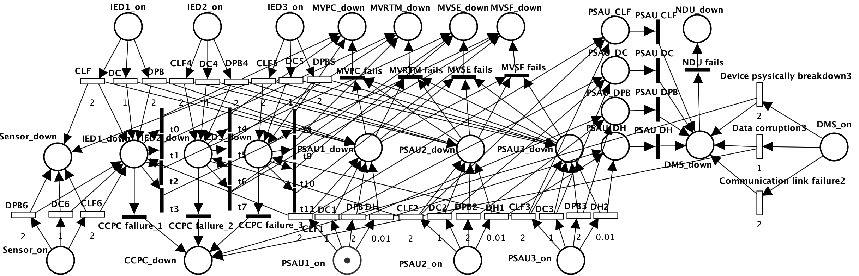
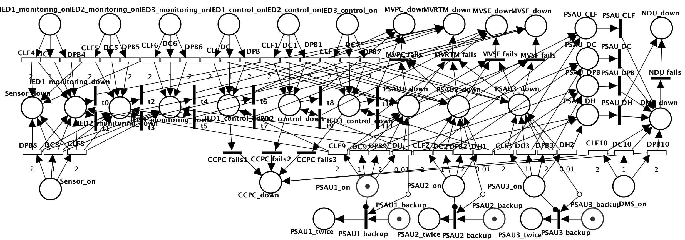
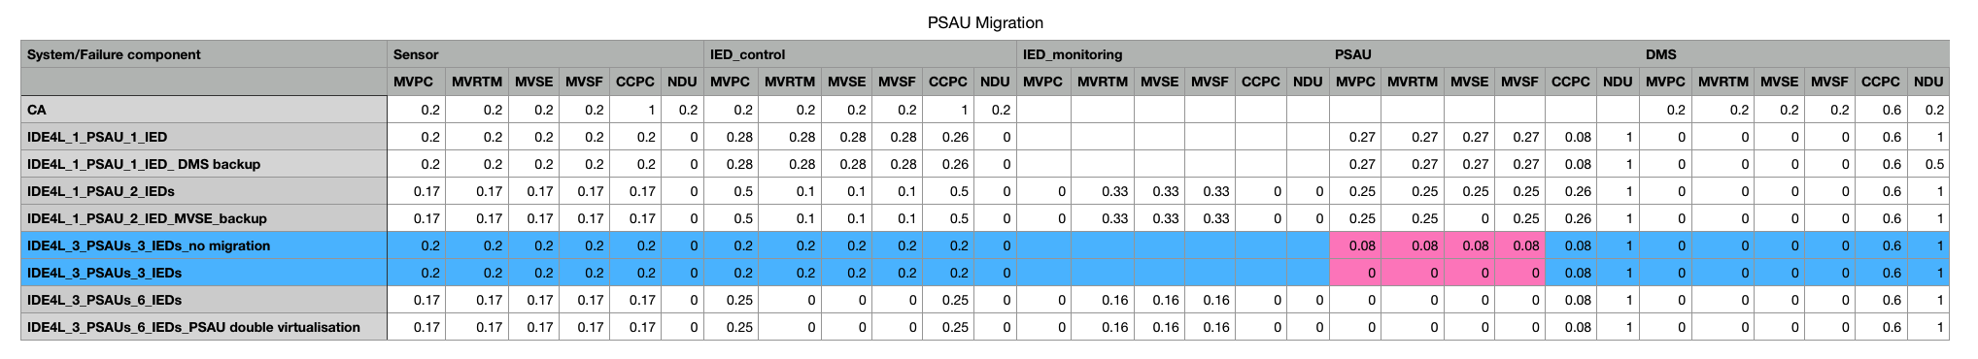
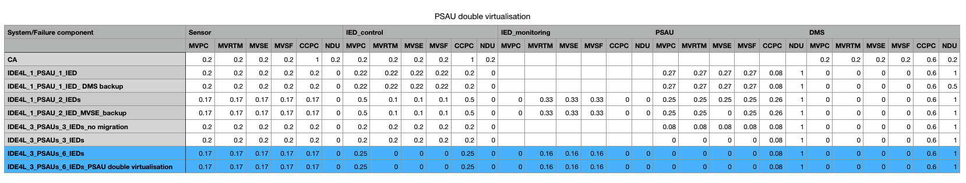
Protection approaches PSAU migration
Protection approaches PSAU double virtualization
IDE4L automation distribution architecture with PSAU migration（migration of all the functions）
one Sensor, one or three IED, three PSAUs and one DMS
Double virtualization: The functional and data layers, which will contain functional and data entities, will be logically separated.
One Sensor, one IED, one PSAU and one DMS

Slide 15
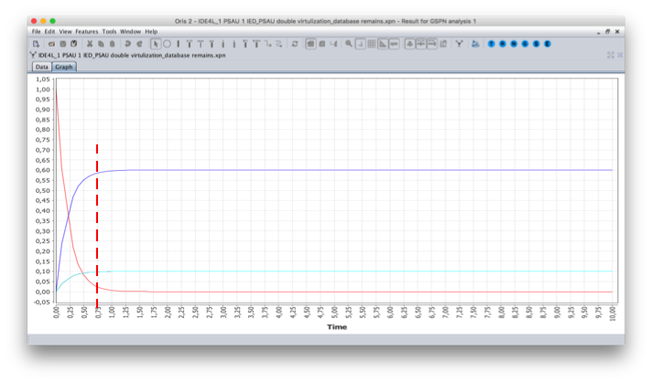
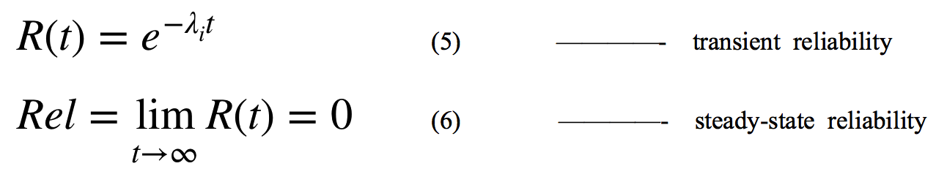
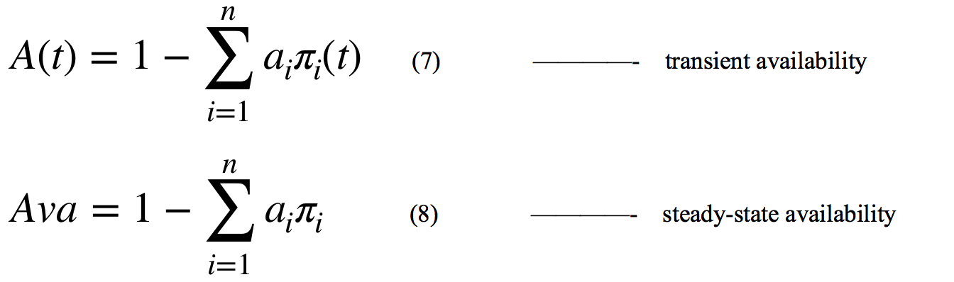
Performance analysis KPI: Key Performance Indicator
1.Reliability
the capability of each component to continuously provide services without failures.
2.Availability:
the resilience of correct services for some critical components.
Transient period is very short (less than 1s).
Using steady state availability as the KPI.

Slide 16
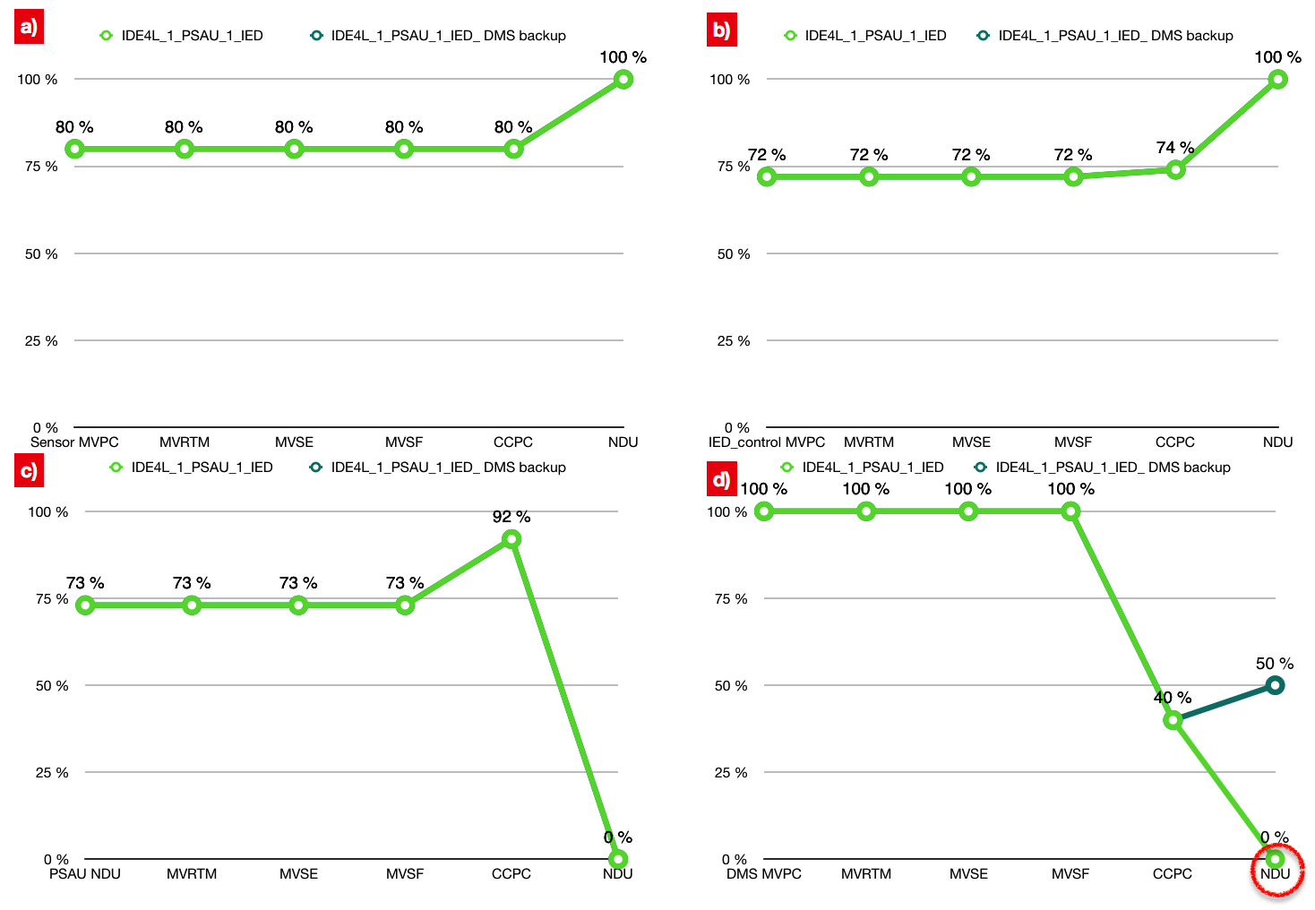
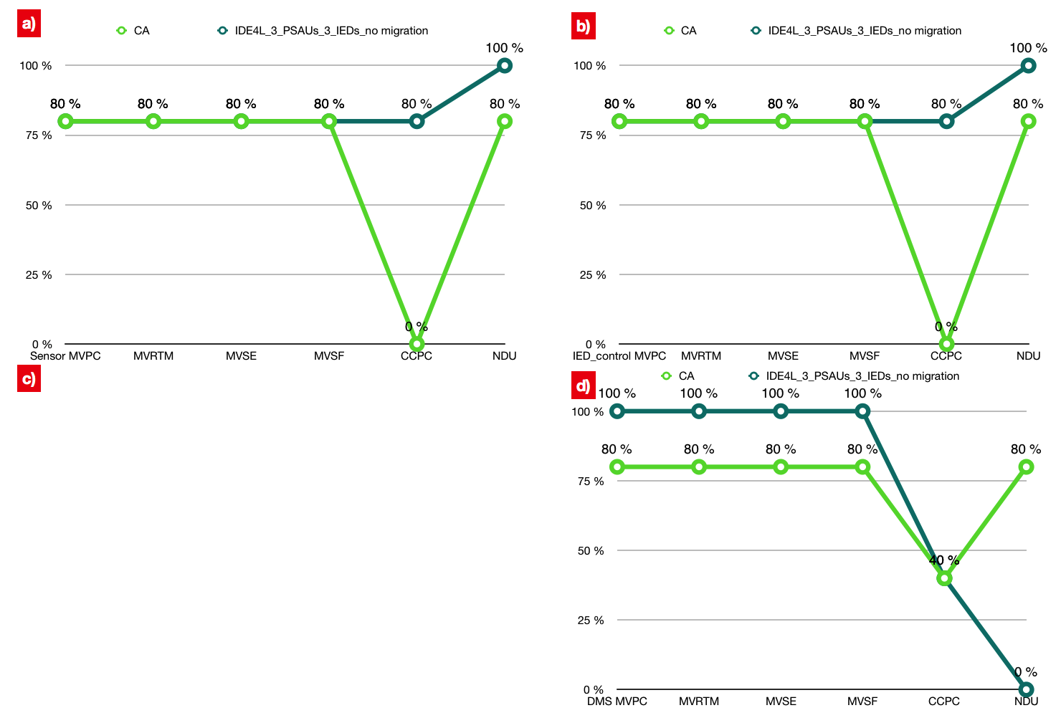
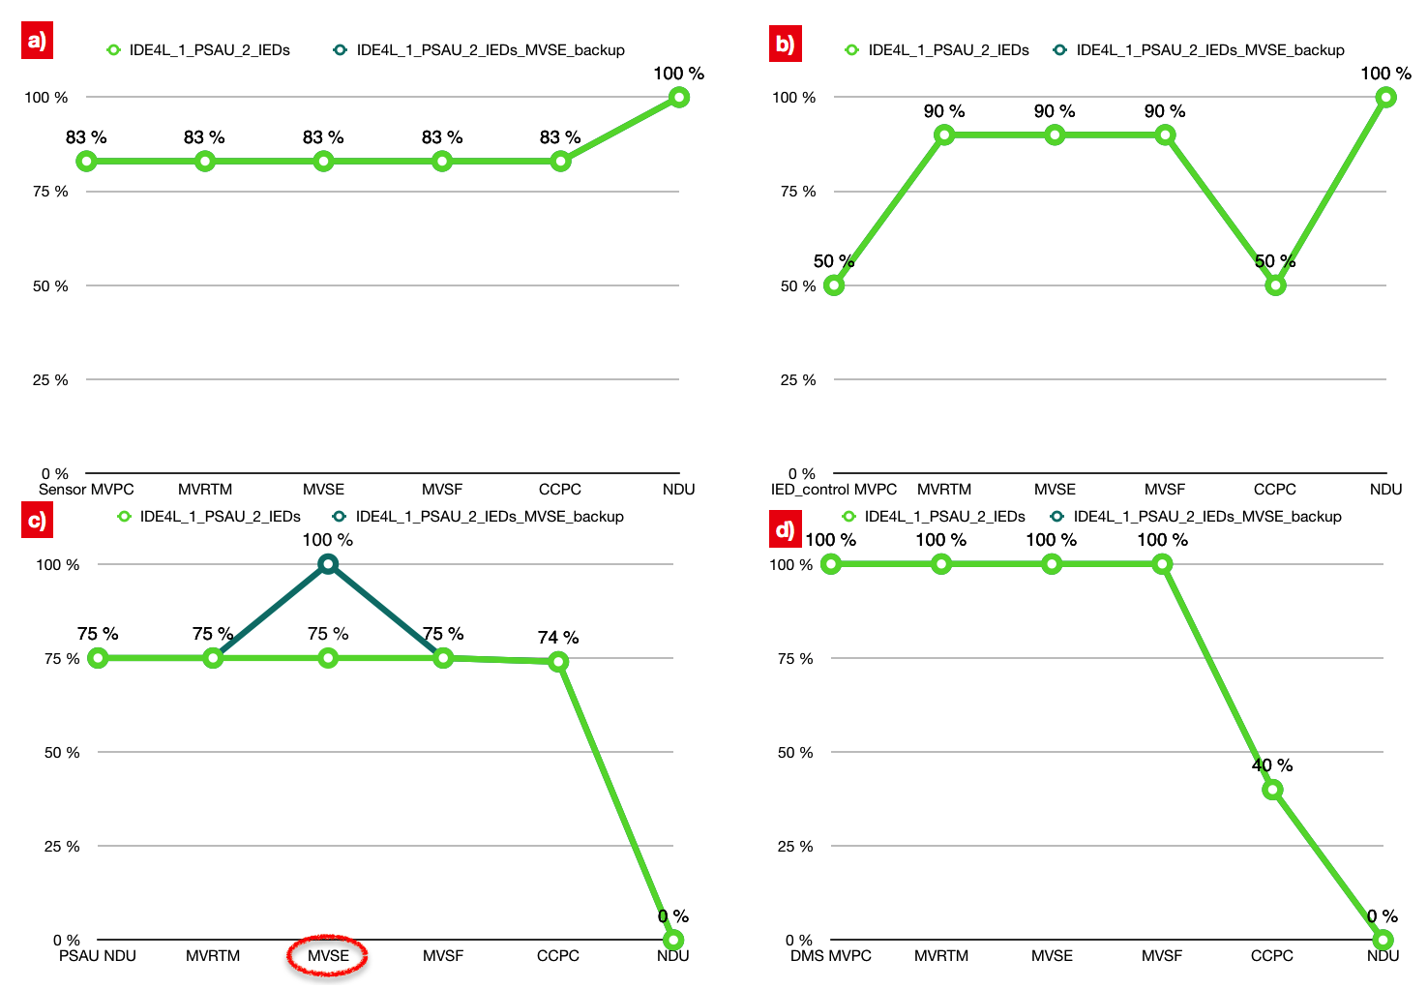
KPI Steady state availability
Compared with centralized automation,IDE4L significantly improve the availability of most use case. Availability of a few use cases decrease, which can be avoided through following protection approaches.
DMS backup strategy is most targeted for the protection of DMS，especially irreplaceable for NDU.
Bad/Missing data detection/correction mainly protects MVSE in case of PSAU failure.
a)in case of sensor failure
b)in case of IED_control failure
c)in case of PSAU failure
d) in case of DMS failure
e)In case of IED_monitoring failure

Slide 17
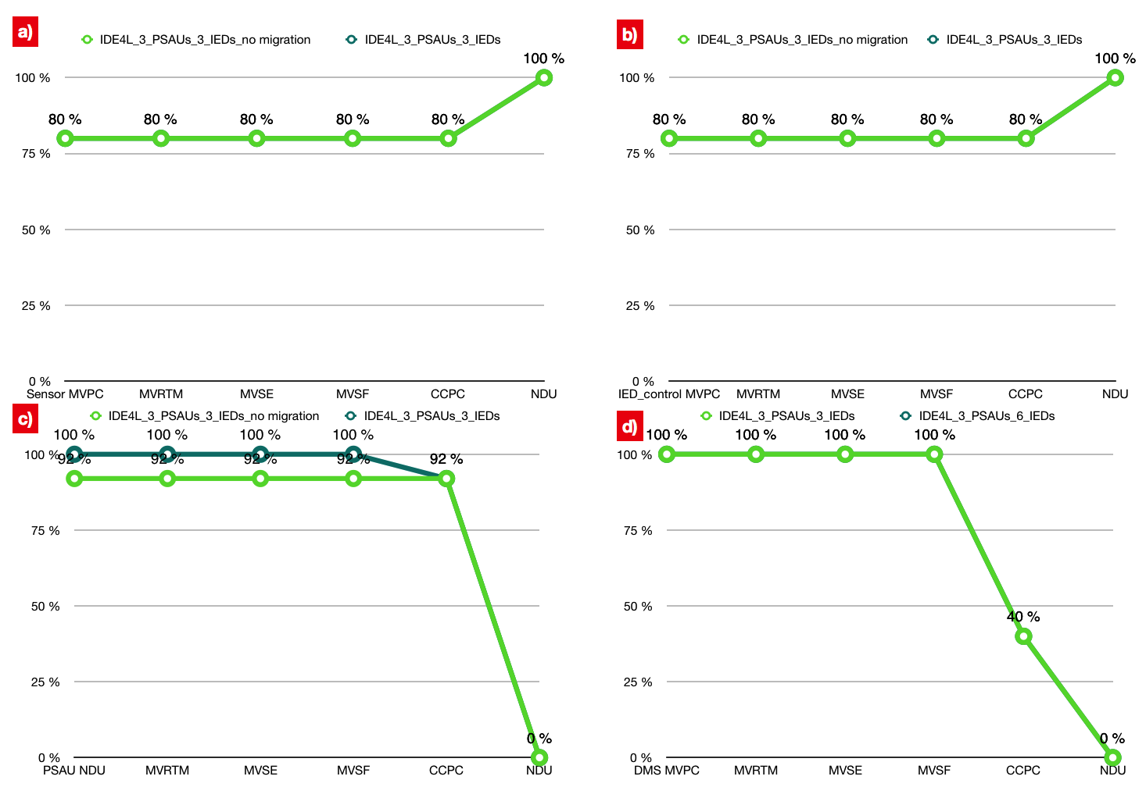
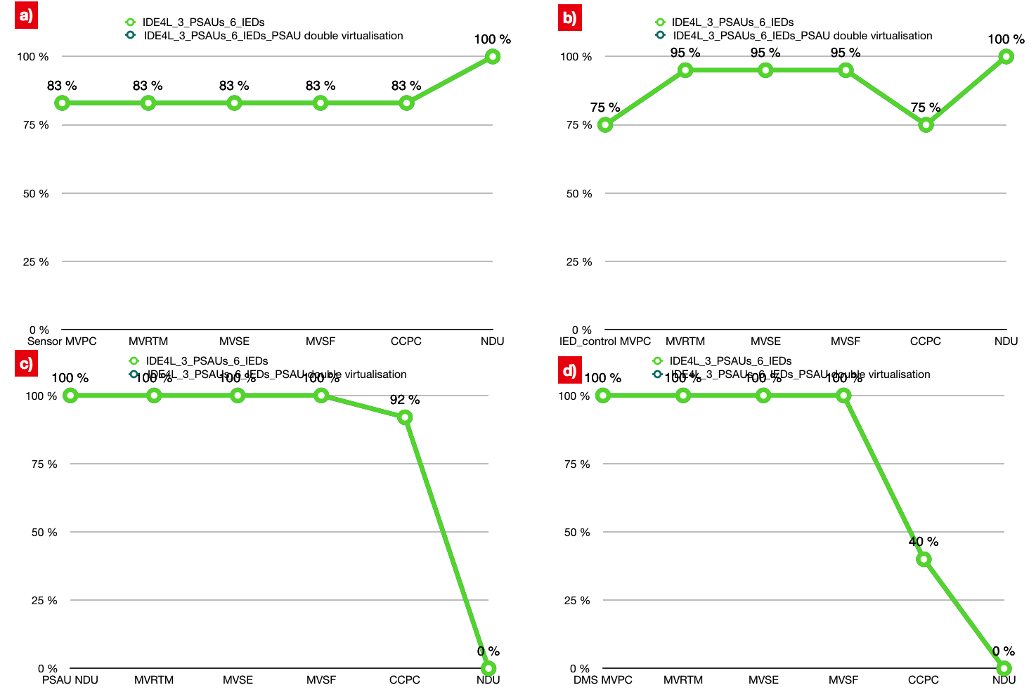
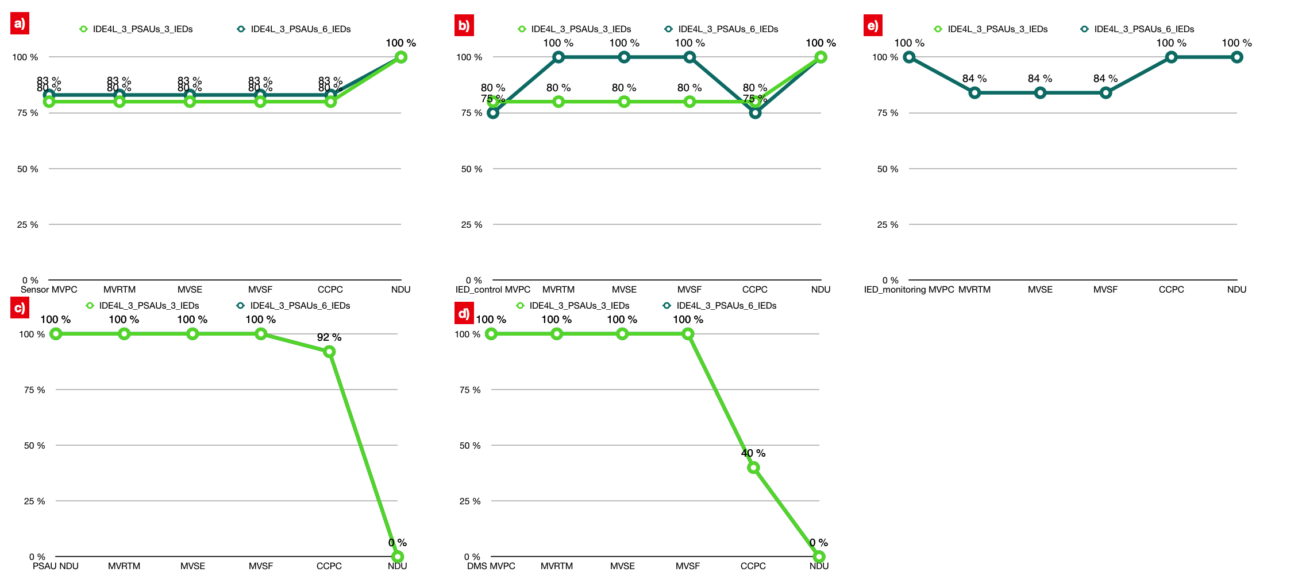
KPI Steady state availability
PSAU migration is the most powerful protection approach, with a strong protective effect all use cases in case of PSAU failure.
PSAU double virtualization and PSAU migration logically have the same affect.
The functional separation on IED can improve the availability most use cases in case of Sensor and IED failure.

Slide 18
Conclusion
Summary
The Goal to evaluate the feasibility of Petri Nets of modeling a distribution automation system
Basic UCs in MV level presented (SCPN)
Modeling the failure modes (STPN)
Quantifation of the system performance is presented
Survivability
Dependability
Overview of different protection approaches
Future work
Define better protection methods for the core components
Detailed transition procedure modeling (e.g. communication process)
Avoidance of the state space explosion problem that may occur in the calculation

Slide 19
Thanks for your attention!
Any question?
Contact
E.ON Energy Research Center
Mathieustraße 10
52074 Aachen
Germany
Huiyuan Xiao
T +49 17681596277
Huiyuan.Xiao@eonerc.rwth-aachen.de

